Slide 1
Illinois Center for Rehabilitation and Education – Roosevelt
Transition and Pre-Employment Program
1950 West Roosevelt Road
Chicago, Illinois 60608

Slide 2
Transition is defined as:
A coordinated set of activities for a student, designed within an outcome-oriented process, that promotes movement from school to post school activities, including post-secondary education, vocational training, integrated employment (including supported employment), continuing and adult education, adult services, independent living, and community participation.

Slide 3
ICRE-R
A 2-plus year Residential, Transition, Pre-Employment Program
Part of the Illinois Department of Human Services, Division of Rehabilitation Services
Located in the Chicago Medical District

Slide 4
ICRE-R Students
Individuals with physical challenges and other health impairments
Ages 18 – 22 years of age
Have completed their high school requirements
Have banked their high school diploma
Have a current IEP or 504 Plan

Slide 5
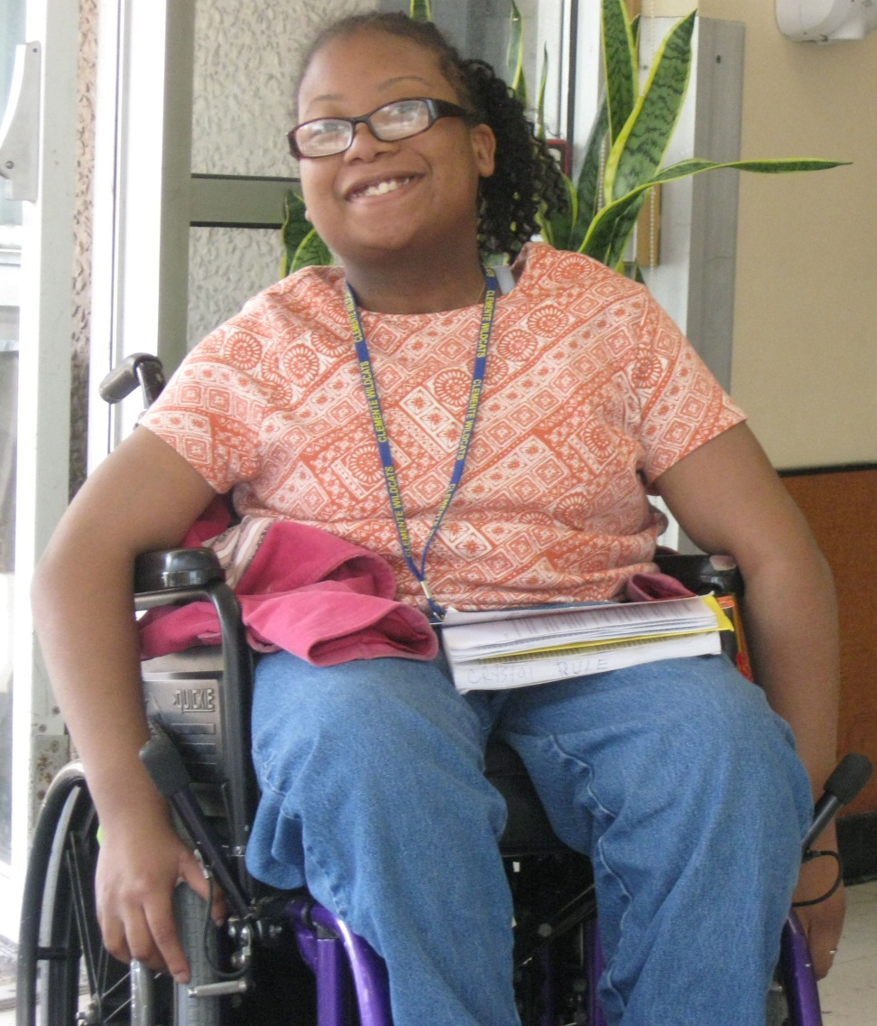
ICRE-R Mission
To prepare young people with severe physical disabilities for a successful adult life through a comprehensive program of education and training.

Slide 6
ICRE-R Values
Individual needs and promotes programs that address specifically identified goals for each person.
The importance of families and works to assist young people and their parents/guardians/families to receive the services they need.
The community and works in conjunction with agencies to identify students in need of services and to provide assistance in linking students with services available in the community.
Advocacy and emphasizes empowerment of young people with disabilities to voice their concerns and participate in state and national advocacy activities.
Employment and provides opportunities for young people with disabilities to develop vocational skills and pursue employment goals consistent with their abilities.

Slide 7

A dream becomes a goal when action is taken toward achieving it…

Slide 8

ICRE-R’s role…
Support each student in setting and reaching realistic goals.

Slide 9
ICRE-R program
Skills are taught in sequential steps.
Students progress at their own pace.
STEP 1
STEP 2
STEP 3
Students work to achieve their personal best.

Slide 11

Students take on more responsibilities…
And develop increasing levels of independence.
THE RESULT: more life choices.

Slide 12
ICRE-R Services
Admissions
Assistive Technology
Case Management
Communication Therapy
Community Housing
Education/Vocational Services
Health Service
Mobility Access Program- MAP
Occupational Therapy
Physical Therapy
Residential Services
Social Services

Slide 13
STUDENT SUPPORT SYSTEM
ICRE-R staff want each student’s program to meet their needs as a whole person.
We work as a team so that the skills each student accomplishes combine to make them a successful person. The student is the most important member of their support system.

Slide 14
Independent living
features
Residential Program – Monday through Friday
Day Program – Monday through Friday
Graduated living environments – single room, mini apartment, on campus apartments
24-hour nursing and residential support services

Slide 15
EDUCATION
PROGRAM FEATURES
Programs are based on student’s strengths, preferences and interests
Collaborates with local community school districts and vocational rehabilitation services
Partner with local Chicago City Colleges and local businesses
Accredited through North Central Association-Commission on Accreditation and School Improvement

Slide 16
ICRE-R Curriculum
Includes :
Heat Press
Retail Training
Business Software
Employability Skills
Graphic Design
Internships
Drone Program
3D Printing
Computerized Embroidery/Sewing
Computer Repair
Adaptive Swimming
Career Planning
College Prep
And Many More….

Slide 17
STEP WORK PROGRAM
BUILDING-WIDE PLACEMENTS
  Students build a resume
  Complete job application
  Practice interviewing skills with ICRE-R staff.
  Volunteer in the community and/or participate in
  an internship
  Receive on site paid work experience.

Slide 18
Community resources
Program features
Rich and diverse local community providing many options for student involvement
Interact with local community colleges and training programs
Collaborate with community entitlement agencies, such as Social Security, Secretary of State, Para transit Services, Home Services, etc.
Multiple accessible cultural opportunities

Slide 19
Volunteer Work
Employment
Doctor Appointments
College
Internships
Off-Campus Events
Trips to the Mall
Rock Climbing
Grocery Shopping
Swimming
Special Events

Slide 20
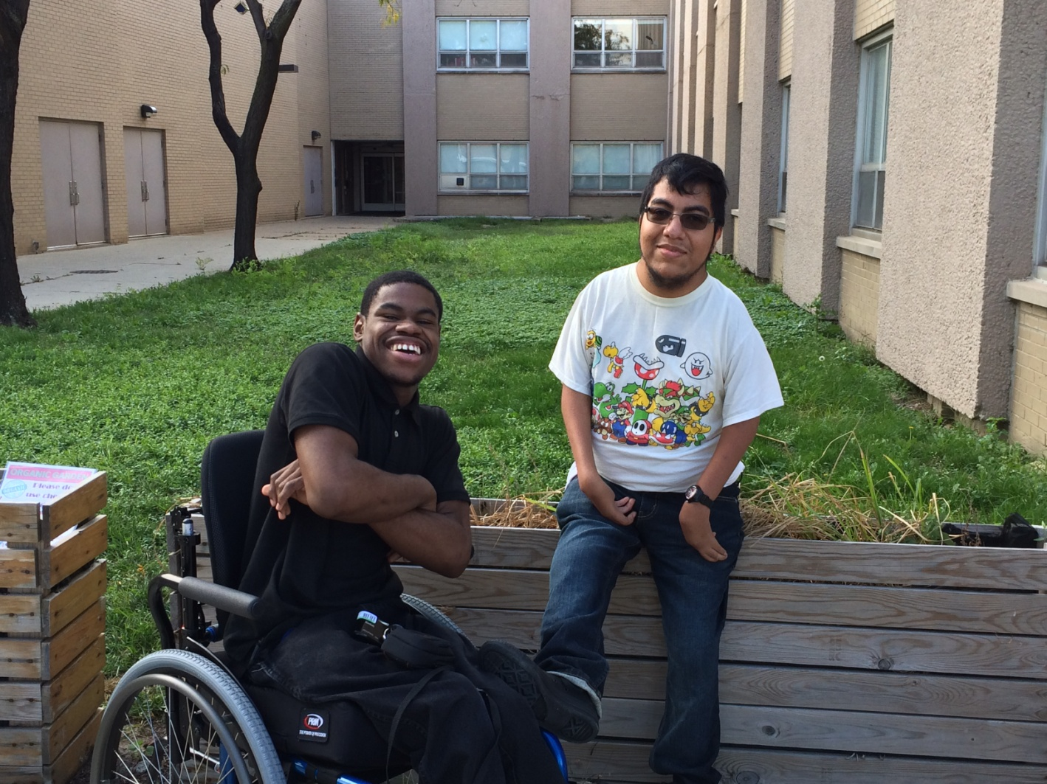
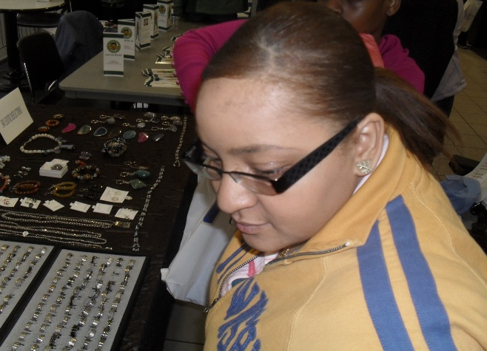
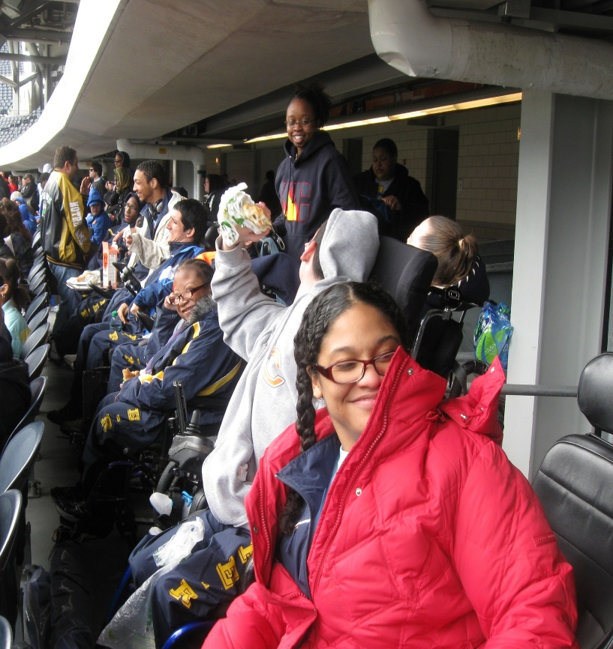
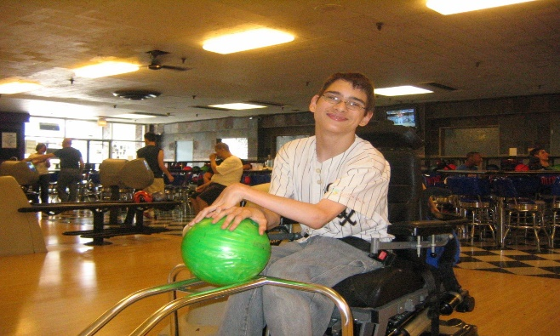
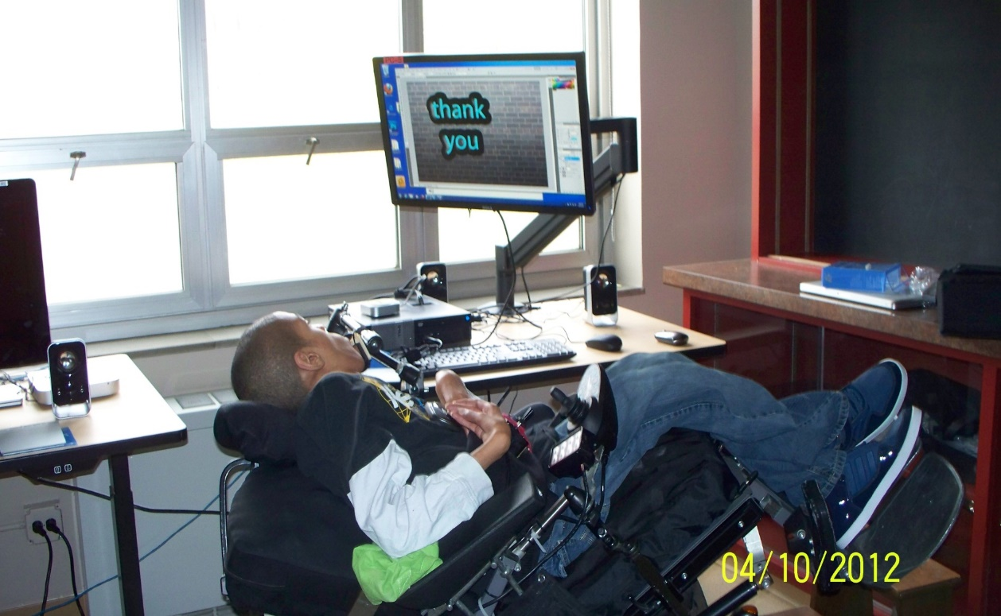
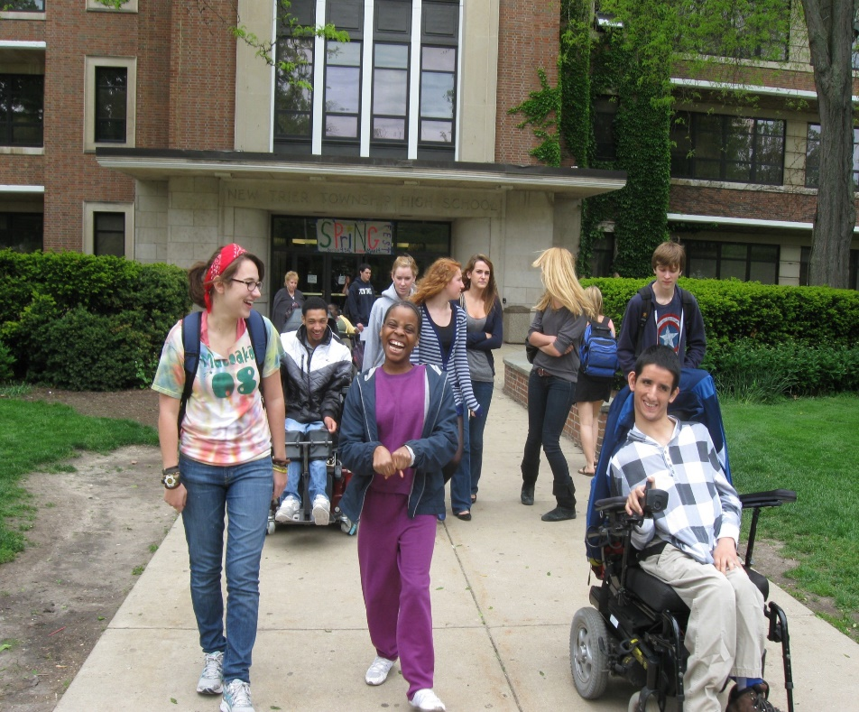

Slide 21


Slide 22
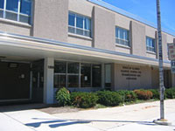
Illinois Center for Rehabilitation and Education – Roosevelt
1950 West Roosevelt Road
Chicago, Illinois 60608
Superintendent: Letitia Doe 312-433-3121
Admissions Service: Gemillia Staple 312-433-3152

